Slide 1
Harbourmasters A
Skeleton Mock Implementation

Slide 2
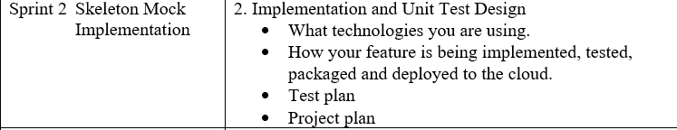
Sprint 2

Slide 3
Project plan
Dummy data set.
Api’s call through Postman
Crud not tested- however facility is there.
Issue with linking database/ MariaDB to java
However the java classes and functions have been created.

Slide 4
Feature description
Api/bookPilot
(after the shipping line has booked with the port owners and confirmed
date/ship object)
REQ: Destination_berth (or berthing reference?)required & current co-ords of ship.
Api/pilotCatalogue (internals)- Crud operations for pilots.

Slide 5
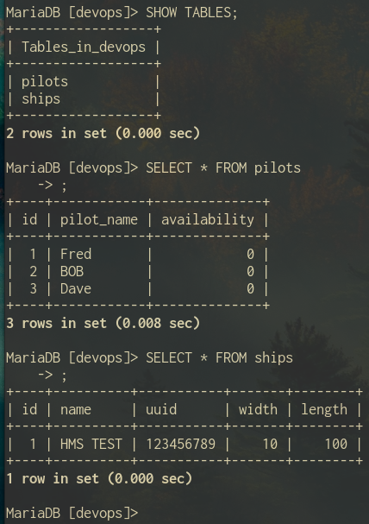
MARIAHDB- mysql tables

Slide 6
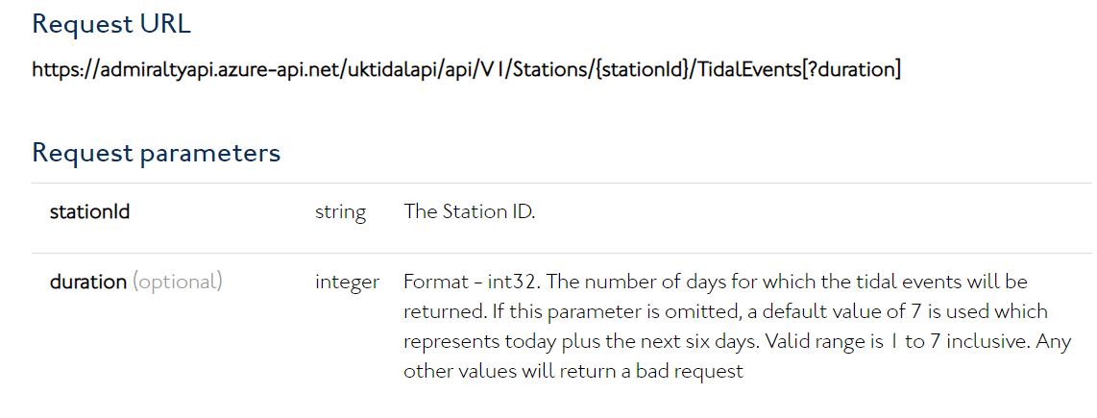
Tidal API
https://admiraltyapi.portal.azure-api.net/docs/services/uk-tidal-api/operations/TidalEvents_GetTidalEvents?

Slide 7
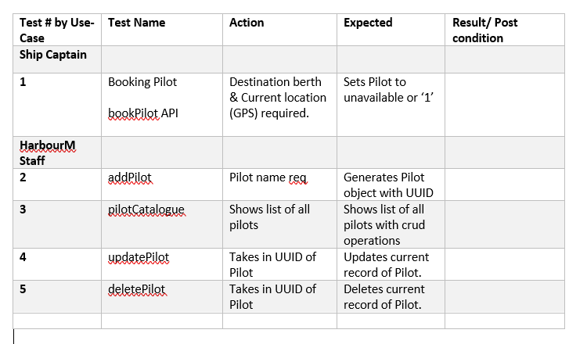
Test plan
Each feature will be tested using the Junit library.
All use-cases and conditions will need to be tested.
Rest features
DB connection

Slide 8
Docker deployment
Docker Container/ Docker compose
mvn clean install -P packageAsDocker
docker build -t container .
mvn spring-boot:build-image
Not yet successful at creating a working docker container*

Slide 9
Technology evaluation
Technology | Usecase
Sprinboot | Framework for the application- checks dependencies
JSP’S/ Tomcat | Java server pages/ front end using Tomcat server through Maven
Swagger | API documentation- *testing to be done.
Postman | Testing ReST calls
MariahDB | SQL database – structured, uses queries
GithuB Projects/Actions | Workflow and task management
JUNIT | Testing unit for Java
Docker → Azure | Docker containers allowing us to integrate our project with other groups

Slide 10
API’s
Please communicate if you need any further API than booking pilots at this time.
Next task
Scheduler

